Slide 1
Predicting the Hourly Wage of Full-Time Employees in Canada
Harpreet Kang
Student ID: 500127314
Git Hub Link: https://github.com/harpkang/CIND820_CAPSTONE

Slide 2

OVERVIEW
Notes:
The Overview

Slide 3
Project Scope
Problem: What machine learning models can be used to predict an individual's wage with minimum error.

Slide 4
Research Questions
Which classification model, with tuned hyper parameters, will have a high accuracy and f1-score, and balanced precision and recall?
What do data mining techniques, specifically association rules, reveal about the link between a high education level and above average hourly earnings?
Which non-linear regression model, with tuned hyper parameters, will have a strong RMSE in regard to the continuous response variable?

Slide 5


Tools Used
ML Methods Used
Python
RStudio
Decision Tree
Naive Bayes
Notes:
Tools
We used the following Tools: Python (Weka and Sklearn), SAS, and RStudio to help with our ML models.

Slide 6
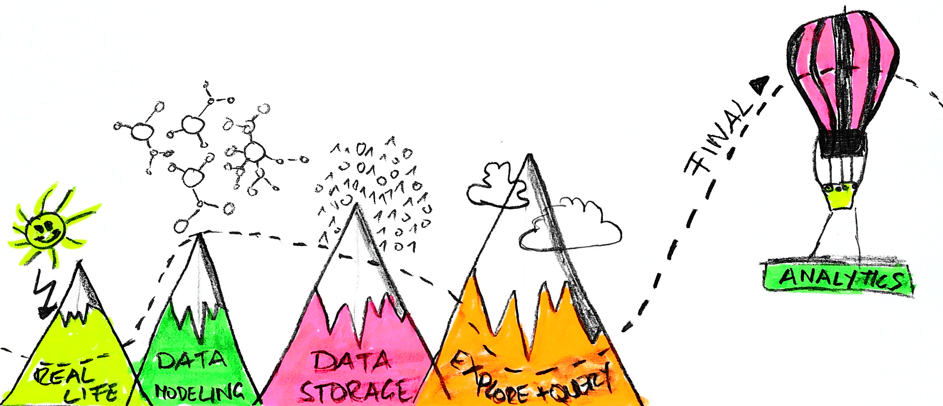
Preparing the Data
Notes:
Data Preparation

Slide 7

Understanding the Dataset
Bank Marketing Dataset
4521 Rows
17 Attributes
Age Day
Job Month Marital Duration
Education Campaign
Default Pdays
Balance Previous
Housing Poutcome
Loan Y
Contact
Notes:
Understanding the Dataset
The dataset we possess is of a previous telemarketing campaign with its respective outcome for each client in the sample.
We will be using this sample to perform our data analysis in order to provide next steps for the Portuguese bank.
Here we see an overview of the dataset, which has 4,521 rows and 17 features that we will use to run our Decision Tree and Naive Bayes models.

Slide 8
Distributions

Slide 9
Outliers

Slide 10
Balanced

Slide 11
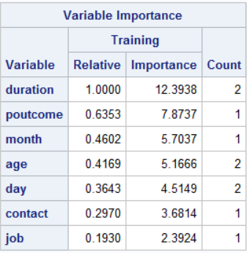
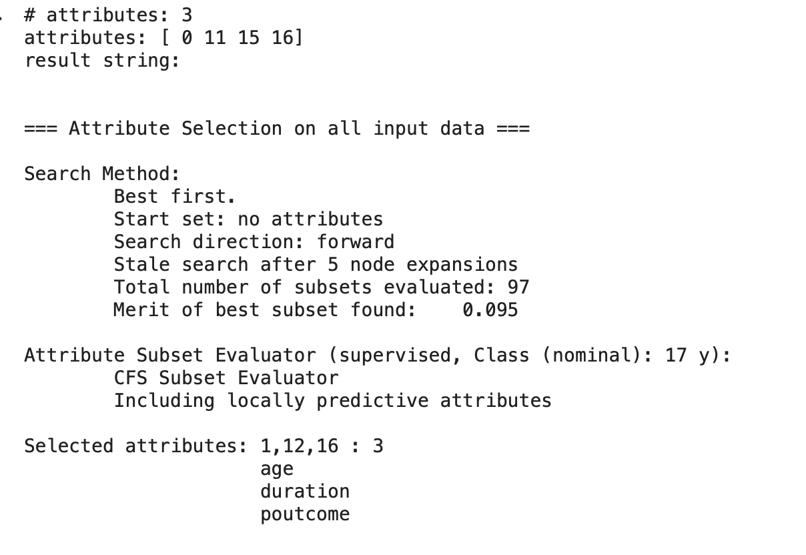
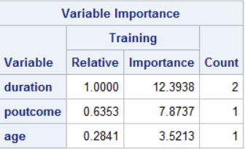
Feature Selection/Processing
According to sklearn documentation:
“Able to handle both numerical and categorical data. However, the scikit-learn implementation does not support categorical variables for now. Other techniques are usually specialized in analyzing datasets that have only one type of variable”
We used all the features for the first test of both models.
We selected features based on Sklearn, R, SAS , and Weka.
We used the Min Max normalization to scale the features,
Under Sampling and Over Sampling,
Grid Search CV and K Folds.
R | SAS | Weka
Duration | Duration | Duration
Poutcome | Poutcome | Poutcome
Job | Age | Age
Month
Balance
Marital

Slide 12
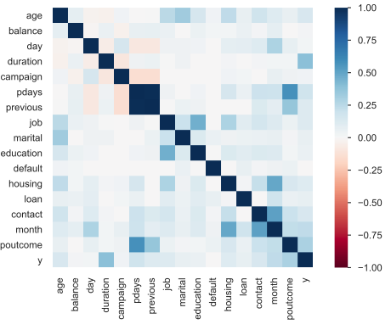
Correlation
Features Correlated | Correlation Strength | Correlated Features to Drop | Scientific Tool
Pdays, Previous, Poutcome | High | Poutcome Pdays | Pandas Profile Report
Contact, Month | High |  | Pandas Profile Report
Notes:
Here we can the Correlation graph that was generated in Pandas Profile Report, and have identified a few features that are highly correlated with each other.
In short we dropped Pdays and Previous because they were correlated with Poutcome, and kept Contact and Month because they were important to our models.
Extra:
We opted to drop Pdays and Previous because Poutcome as we will see later in our models is an important feature, even though we saw in the previous slide that the classification ‘Unknown’ is heavily skewed.
We also decided to keep the features contact and month even though they are correlated with each other, but again we will see that these were important features in the upcoming models.

Slide 13

PREDICTIVE MODELING
Notes:
I will pass it over to Supreet to go over the predictive modelling.

Slide 14
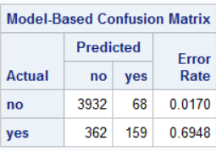
Decision Tree (All Results)
All Features
Class No | Actual (+) | Actual (-)
Predicted (+) | TP : 761 | FP: 50
Predicted (+) | FN: 44 | TN: 49
Compared to R, SAS, and Sklearn.
Accuracy | Precision | Recall | F1 Score
89.60% | 93.83% | 94.53% | 94.18%
Selected Features
MinMaxScaler
KFolds
Grid Search CV
Balanced Class
Class No | Actual (+) | Actual (-)
Predicted (+) | 786 | 23
Predicted (+) | 67 | 29
Label | Weight
Y | Yes: 44.44% No: 55.56%
Accuracy | Precision | Recall | F1 Score
90.06% | 97.16% | 92.15% | 94.59%

Slide 15
Limitations

Slide 16
Conclusion of Predictive Modeling
Model | Accuracy | Precision | Recall
Baseline decision tree | 89.60% | 93.83% | 94.53%
Decision tree on selected features | 90.06% | 97.16% | 92.15%
Baseline Naïve Bayes | 87.50% | 93.80% | 92.05%
Naïve Bayes on selected features | 88% | 90% | 97%
Notes:
Explain the evaluation method you used: cross validation or train-test set split
Fill out the table that will summarize your results
State which model is the best in your case. Are selected-features models they better than the baseline one?

Slide 18
Recommendations
As evident from the models developed from Python, R and SAS-
The related variables to be considered for achieving high customer turnover for long-term investment falls in the following criteria-
Aged 24 and above
Call duration should be more than 10 minutes.
Single and divorced individuals are more likely to invest
Students, Retired persons and Technicians under Job category
pday (delay from the previous contacted date) > 296 days
Impact is more when contacted in the month of Feb, March, April, July, August and December.

Slide 19
The End!

